Slide 1


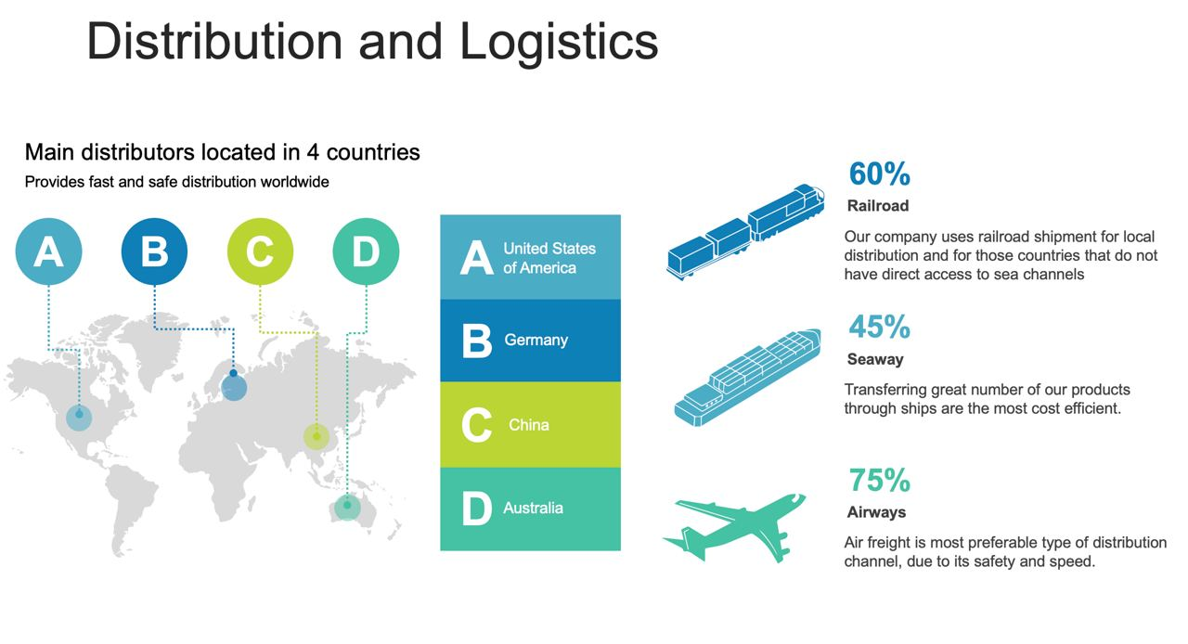
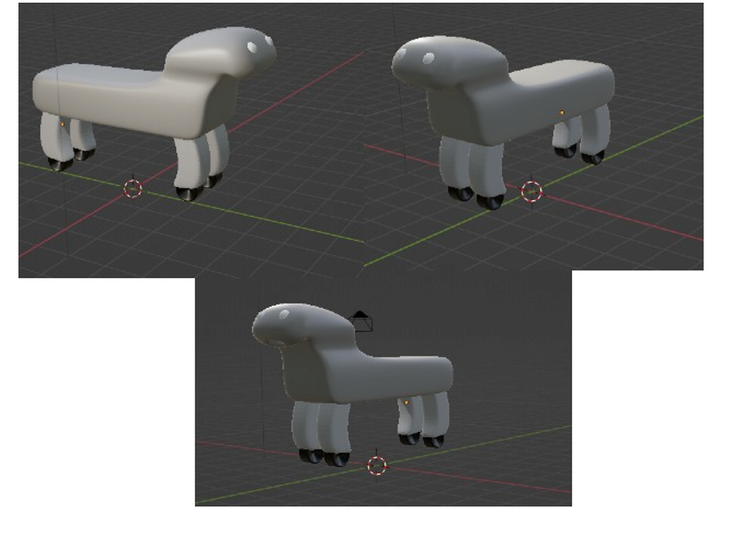
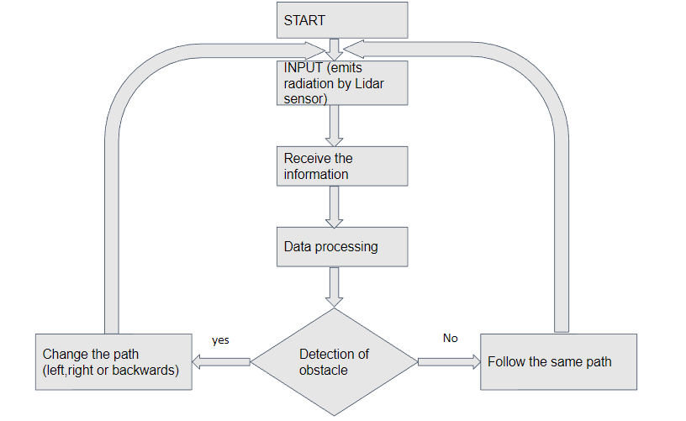

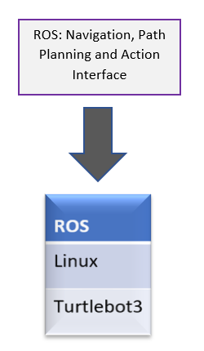
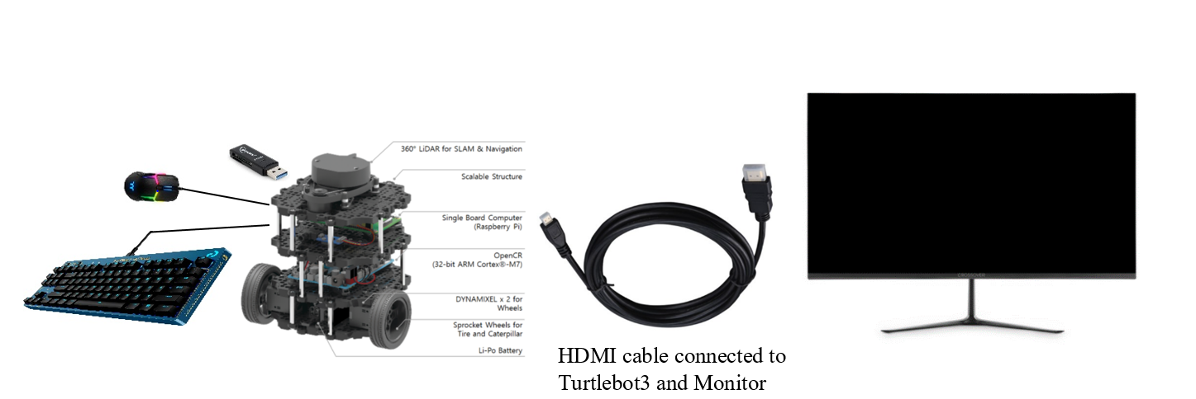
“Helper” GUIDE ROBOT
2022-2 Capstone Project
12194864 Salokhiddin Jalolov
12194905 Rakhmatov Olim
12194245 Begijonov Ruziboy
12194896 Tszin Alina
12194909 Yusupov Elbek
12194939 Tamang Sanjib
TEAM 3
BCM & Product
Distribution
Key Partners
Key Activities
Value Propositions
Tech parts suppliers
Investors
R&D
Production
Marketing Promotions
Cost-efficiency
Guider robots for blind
Safety
Customer Relationships
Key Resources
Personal assistance in physical store
Online Customer Service
Software developers
Salespeople
Intellectual Property
Store/Factory
Channels
Cost Structure
Revenue Streams
Online Stores
Value-added resellers
Physical Stores
Affiliate Marketing
Manufacturing
Marketing
Employees
Rent
R&D
Online Sales
Offline Sales
Promotion, Technology,& Innovation
Target market:
visually impaired and blind people from 20-40 years
like to try new things and experiment
interested in technology and gadgets
prefer convenient and practical products.
Marketing strategy:
Content marketing: creating a company website, posting blogs, uploading educational videos on YouTube
B2B marketing: demonstration shows and lectures, participation in EXPO
3D Design of the Product
Research Method & Process
In depth interviews & observation
4 to 6 visually handicapped
participants
Unstructured interview
Research Method
A Robot that can travel to any destination and doesn’t affect by bad weather conditions.
It can detect obstacles and show the right path for disabled people.
Good travel partner, it can be put into a bag and can be taken on international travels.
Observing the difficulties of
participants while moving
Suggestions for improvements by respondents
Obstacle Avoidance
Summary
Sensor Used:
LDS-02
2D laser scanner capable of sensing 360 degrees that collects data surrounding the robot for SLAM (Simultaneous Localization and Mapping) and Navigation.
Objective: The goal of the project to provide an assistance to blind people using Turtle Bot 3 and T2 ROS.
HOW?: The robot will help disabled people to find their desired
location using map, smart microphone and speakers to tell blind people like SIRI
It will also provide additional information regarding ongoing outside situation even if you don’t ask him to like a partner. This function can be enabled or disabled by user.
Method of operation
SLAM constructs a map by identifying barriers around the robot and estimating the robot’s present position within the map as demonstrated in figure.
Flowchart representing workflow of obstacle avoidance
Experiment environment
Hardware Architecture

